Slide 1
Partnership
central and Eastern European Consultation October 2018

Slide 2
Where are we going?
Define partnership
Practical Learning Experiences
Scriptural Teaching and Practice

Slide 3
Partnership – a Definition
Greek word - koinōnia
Translated and used in various ways in scripture
1) a partner, associate, comrade, companion
2) a partner, sharer, in anything
Thayer

Slide 4
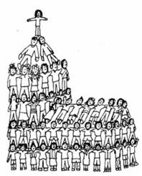
Koinōnia
How believers deal with money
Relationships between believers in the church
Relationship with each other

Slide 5
Koinōnia
Our responsibilities to other believers
Agreements over specific areas of service and cooperation in service
Our relationship with the Holy Spirit
Our relationship with Christ because of his death

Slide 6
Partnership in Prayer

Slide 7
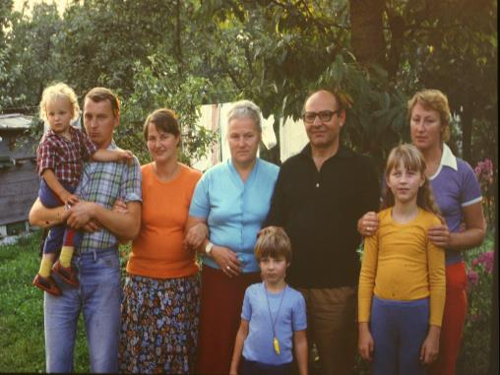
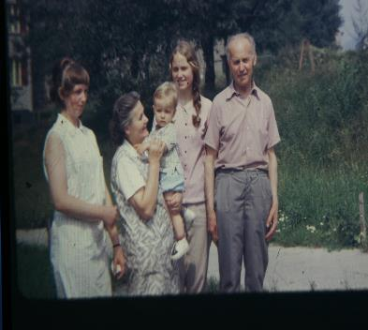
Ždych family
Gwizd Family
Partnership
in hospitality
Ouzký family

Slide 8
Partnership in Hospitality
and Service

Slide 9
Partnership in Hospitality
and Service

Slide 10
Partnership in Service

Slide 11
Partnership in Service

Slide 12
Partnership in Service
Mentoring

Slide 13
Partnership
in Service

Slide 14
What Partnership in the New Testament Involved
“Big Picture” Situations
The work of the local church
The work of individuals

Slide 15
The Big Picture
Apollos
Timothy
Priscilla
and
Aquila
Titus
Peter

Slide 16
Partnership
In Service
In Relationships

Slide 17
Philippian Example
What did “Partnership in Service”
look like?

Slide 18
What is partnership in Service?
In all my prayers for all of you, I always pray with joy because of your partnership in the gospel from the first day until now, being confident of this, that he who began a good work in you will carry it on to completion until the day of Christ Jesus.
Philippians 1:4-6

Slide 19
What is partnership in Service?
In all my prayers for all of you, I always pray with joy because of your partnership in the gospel from the first day until now, being confident of this, that he who began a good work in you will carry it on to completion until the day of Christ Jesus.
Philippians 1:4-6

Slide 20
What was that Partnership? Who were the partners?
Acts 16:13 On the Sabbath we went outside the city gate to the river, where we expected to find a place of prayer. We sat down and began to speak to the women who had gathered there.
Acts 16:14 One of those listening was a woman from the city of Thyatira named Lydia, a dealer in purple cloth. She was a worshiper of God. The Lord opened her heart to respond to Paul's message.
Acts 16:15 When she and the members of her household were baptized, she invited us to her home. "If you consider me a believer in the Lord," she said, "come and stay at my house." And she persuaded us.

Slide 21
What was that Partnership? Who were the partners?
Acts 16:13 On the Sabbath we went outside the city gate to the river, where we expected to find a place of prayer. We sat down and began to speak to the women who had gathered there.
Acts 16:14 One of those listening was a woman from the city of Thyatira named Lydia, a dealer in purple cloth. She was a worshiper of God. The Lord opened her heart to respond to Paul's message.
Acts 16:15 When she and the members of her household were baptized, she invited us to her home. "If you consider me a believer in the Lord," she said, "come and stay at my house." And she persuaded us.

Slide 22
What was that Partnership? Who were the partners?
Acts 16:13 On the Sabbath we went outside the city gate to the river, where we expected to find a place of prayer. We sat down and began to speak to the women who had gathered there.
Acts 16:14 One of those listening was a woman from the city of Thyatira named Lydia, a dealer in purple cloth. She was a worshipper of God. The Lord opened her heart to respond to Paul's message.
Acts 16:15 When she and the members of her household were baptized, she invited us to her home. "If you consider me a believer in the Lord," she said, "come and stay at my house." And she persuaded us.

Slide 23
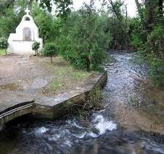
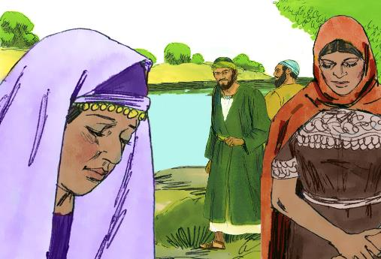
Traditional site of meeting in Philippi – where it all began!

Slide 24
But who was there?
Paul - a learned Jewish Scholar and a Roman citizen
Silas – a prophet, faithful brother a Jew and a Roman citizen
Luke – a learned historian and doctor (the beloved physician Colossians 4:17) and a Gentile
(Almost certainly spoke Greek as a mother tongue)
Timothy – mixed Jewish/ Gentile parentage
Lydia – a successful business woman and a native of Thyatira
The family of Lydia
Other ladies
Very mixed
group
in every way

Slide 25
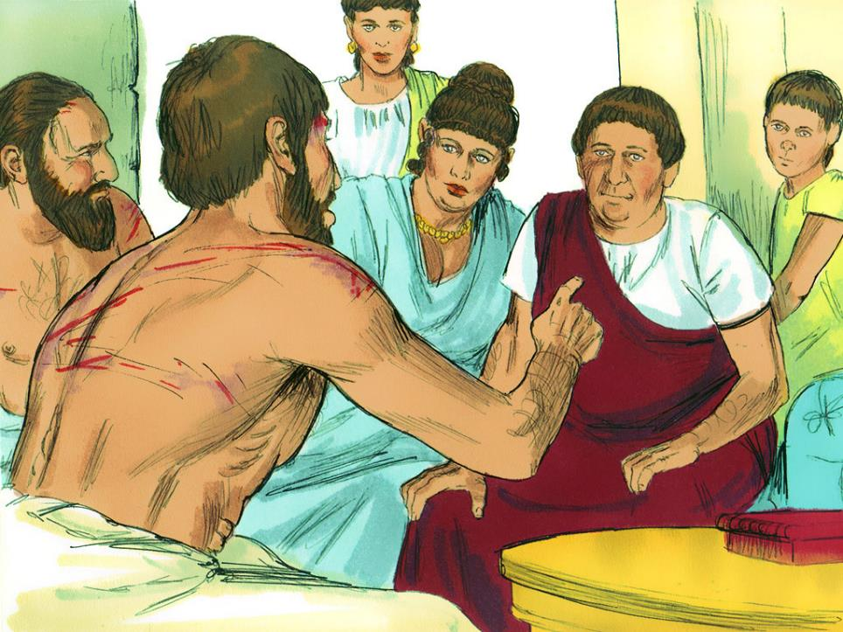
Soon a Jailor and his family
were added

Slide 26
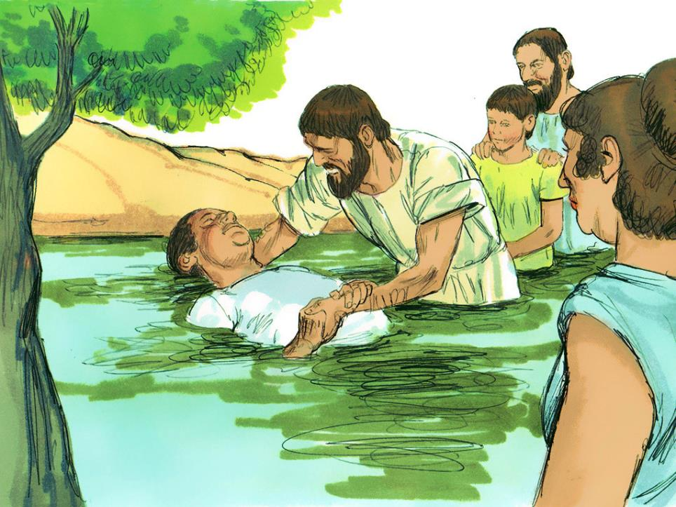
and baptized!

Slide 27
Why was there such an unexpected result?
Partnership with God – being where they were called by God. Acts 16:10
Understanding what the Gospel meant – “they were all one in Christ Jesus” Galatians 3:28

Slide 28
Key Lesson - How is partnership developed ?
Therefore if you have any encouragement from being united with Christ, if any comfort from his love, if any common sharing in the Spirit, if any tenderness and compassion, then make my joy complete by being like-minded, having the same love, being one in spirit and of one mind.
Philippians 2:1&2

Slide 29
Key Lesson - How is partnership developed ?
Therefore if you have any encouragement from being united with Christ, if any comfort from his love, if any common sharing in the Spirit, if any tenderness and compassion, then make my joy complete by being like-minded, having the same love, being one in spirit and of one mind.
Relationship
Philippians 2:1&2

Slide 30
How is partnership developed ?
Therefore if you have any encouragement from being united with Christ, if any comfort from his love, if any common sharing in the Spirit, if any tenderness and compassion, then make my joy complete by being like-minded, having the same love, being one in spirit and of one mind.
Relationship, Partnership
Philippians 2:1&2

Slide 31
How is partnership developed ?
Therefore if you have any encouragement from being united with Christ, if any comfort from his love, if any common sharing in the Spirit, if any tenderness and compassion, then make my joy complete by being like-minded, having the same love, being one in spirit and of one mind.
Relationship, Partnership, Commitment
Philippians 2:1&2

Slide 32
What is the evidence of a Holy Spirit driven Partnership?
But even if I am being poured out like a drink offering on the sacrifice and service coming from your faith, I am glad and rejoice with all of you. Philippians 2:17

Slide 33
What is the evidence of a Holy Spirit driven Partnership?
But even if I am being poured out like a drink offering on the sacrifice and service coming from your faith, I am glad and rejoice with all of you. Philippians 2:17

Slide 34
What is the evidence of a Holy Spirit driven Partnership?
But even if I am being poured out like a drink offering on the sacrifice and service coming from your faith, I am glad and rejoice with all of you. Philippians 2:17

Slide 35
What is the evidence of a Holy Spirit driven Partnership?
But even if I am being poured out like a drink offering on the sacrifice and service coming from your faith, I am glad and rejoice with all of you. Philippians 2:17
Sacrificial living and commitment

Slide 36
Our Responsibility – the Philemon Example
Extreme Example:
A wealthy Roman Citizen
His wife and son or brother
The church that meet in their house
A thief who was a slave
The apostle Paul

Slide 37
The Process
Paul’s recognition of the reality of the situation and his responsibilities.
His need to lead the process.
His need to be a guide and a mentor to all involved.

Slide 38
The Reality
The situation was a challenge to the social and political order.
There were personal issues between Philemon and Onesimus.
Whatever the outcome Philemon’s relations, the church that met in their house and the community in Colossae would be impacted.

Slide 39
The Starting Point
Paul considered both the key players his partner.
“I pray that your partnership with us in the faith may be effective in deepening your understanding of every good thing we share for the sake of Christ” 1:6.

Slide 40
The Starting Point
Paul considered both the key players his partner.
He has become useful both to you and to me. I am sending him—who is my very heart—back to you. I would have liked to keep him with me so that he could take your place in helping me while I am in chains for the gospel. 1:11b -13

Slide 41
Paul’s Goal
He is very dear to me but even dearer to you, both as a fellow man and as a brother in the Lord. So if you consider me a partner, welcome him as you would welcome me. 1:16b-17.

Slide 42
Paul’s Goal
He is very dear to me but even dearer to you, both as a fellow man and as a brother in the Lord. So if you consider me a partner, welcome him as you would welcome me. 1:16b-17.

Slide 43
The Mentoring Process
Consider the options
Therefore, although in Christ I could be bold and order you to do what you ought to do, yet I prefer to appeal to you on the basis of love. 1: 8-9a
Authority

Slide 44
The Mentoring Process
Consider the options
Therefore, although in Christ I could be bold and order you to do what you ought to do, yet I prefer to appeal to you on the basis of love. 1: 8-9a
Authority or Persuasion

Slide 47
What the issues are?
How should they be addressed?

Slide 48
Positively
He describes Philemon as “our dear friend” 1:1.

Slide 49
Positively
He describes Philemon as “our dear friend” 1:1. It was the team view.
He describes his love and faith, “I hear about your love for all his holy people and your faith in the Lord Jesus” 1:5.

Slide 50
Positively
He describes Philemon as “our dear friend” 1:1. It was the team view.
He describes his love and faith, “I hear about your love for all his holy people and your faith in the Lord Jesus” 1:5.
He acknowledges the encouragement Philemon has been,”Your love has given me great joy and encouragement, because you, brother, have refreshed the hearts of the Lord's people” 1:7.

Slide 51
Positively
He describes Philemon as “our dear friend” 1:1. It was the team view.
He describes his love and faith, “I hear about your love for all his holy people and your faith in the Lord Jesus” 1:5.
He acknowledges the encouragement Philemon has been,”Your love has given me great joy and encouragement, because you, brother, have refreshed the hearts of the Lord's people” 1:7.

Slide 52
Positively
He acknowledged the expected outcome, “Confident of your obedience, I write to you, knowing that you will do even more than I ask” 1:21.

Slide 53
Positively
He acknowledged the expected outcome, “Confident of your obedience, I write to you, knowing that you will do even more than I ask” 1:21.

Slide 54
Be sure of the Issues
The constraints of Roman law.
Onesimus’Actions – he had stolen money and in so doing betrayed Philemon’s trust.
The spiritual dimension, God had intervened in the lives of Philemon and Onesimus

Slide 55
Resolving the Problems of Roman Law
Paul used Roman Law.
The “Law of Fortum” demanded that anyone who found a slave should send him back.
Paul wrote, “I am sending him back to you”1:12. This was the law.
The law stated that the slave had no rights in this or any situation. The owner could do as he pleased.
Paul reminded Philemon of this by the comments which follow.

Slide 56
Resolving the Problems Debt
Paul used Roman Law again
He offered to pay the debt.
“If he has done you any wrong or owes you anything, charge it to me. I, Paul, am writing this with my own hand. I will pay it back—not to mention that you owe me your very self,” 1:18&19.

Slide 57
Resolving the Problems The Spiritual Dimension
“My very heart”
“The Sovereign will of God”
“Has become useful to you and to me”
“Perhaps the reason he was separated from you for a little while was that you might have him back forever, no longer as a slave, but better than a slave, as a dear brother. He is very dear to me but even dearer to you, both as a fellow man and as a brother in the Lord.” 1:16&17

Slide 58
Spiritual Partnership
The way to live and serve

