Slide 1
Developing Leaders for the 21st Century
Working towards succession

Slide 2
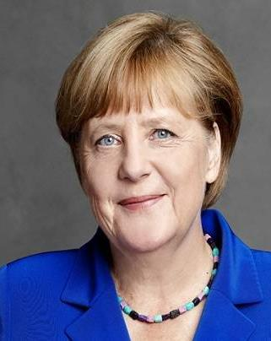
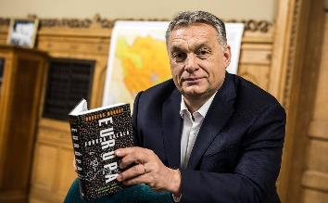
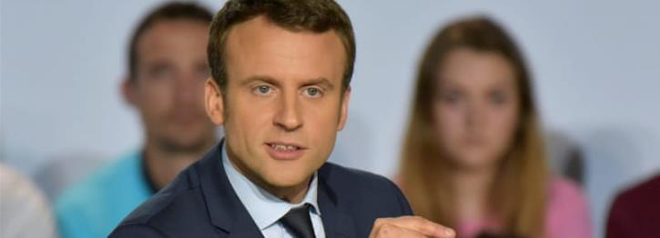
Models of Leadership
Is this the model of leadership for the church?

Slide 3
Distinctiveness of Christian Leadership
Leadership is a gift from God
Leadership involves sensitivity God and people
Leaders are role models
Leadership brings people into the spiritual realm

Slide 4
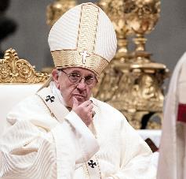
Where does authority fit?
Structural authority – office
Personal authority – skill
Imposed authority – personality
Moral authority - integrity

Slide 5
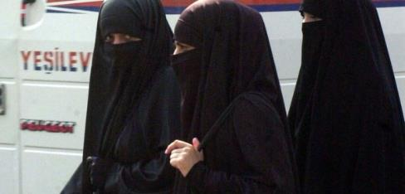
Our changing context
Global village
Worldview challenges
Moral decline
Personal demands
Institutional memory

Slide 6
What kind of leaders do we want?
Quality determined by Jesus
Role guided by scripture
Methods shaped by the context
Succession prepared for intentionally

Slide 7
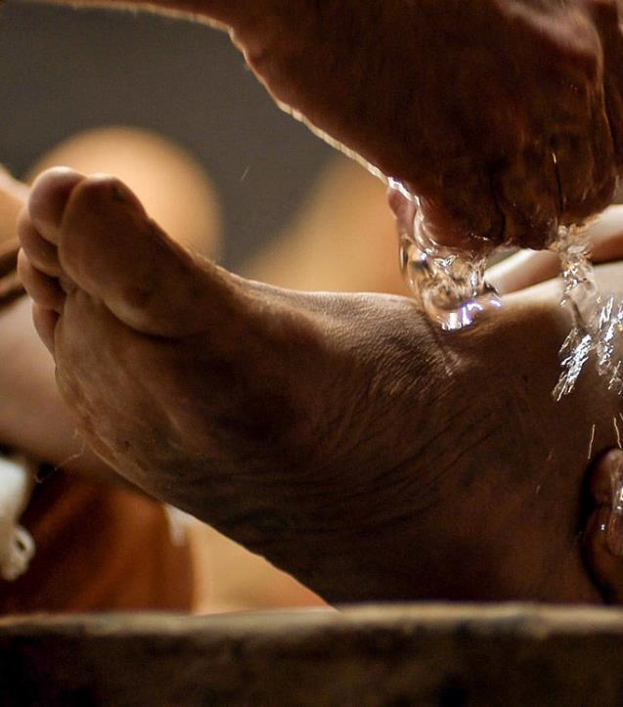
1. A Servant heart – Jn.13:1-5
V.3 Jesus knew who he was
V.1 Jesus understood his mission
V. Jesus was motivated by love
V.4-15 Jesus modelled greatness based on service

Slide 8
How to create a servant heart
Model
Model it yourself
Promote
Promote unseen tasks
Encourage
Encourage self sacrifice

Slide 9
2. Pure motives
What is my motivation?
Am I shaped by culture, man’s opinions or God’s will?

Slide 10
3. Reliance on God
Bring about
Only God can bring about transformation
See
Only God can see the future
Sustain
Only God can sustain us

Slide 11
4. Getting the ‘Big Picture’
Tension in church
Spiritual malaise
Strategy not working
Personal sin and problems
Teach listening and observation skills
Teach analytical skills
Teach solution driven strategies
Teach flexibility

Slide 12
5. Maximising potential
Discovering
Discover personal passion
Discovering and refining
Discover and refining gift
Teaching
Teaching evolutionary thinking
Balancing
Balancing vision, priorities and timing

Slide 13
6. Grace under pressure
The challenge of lay led ministry
The challenge of work, life, family balance
The challenge of expectations
The challenge of personal weakness
The challenge of the battle

Slide 14
7. Organised lives
Locating and increasing personal capacity
01
Balancing many priorities
02
Short, medium and long term thinking
03

Slide 15
Goal setting
Where do I want to be in 5 years
Where would I want the church to be in 5 years
We cannot teach what we do not practice

