Slide 1
Growing Churches
The Why, How and What about growing churches.

Slide 2
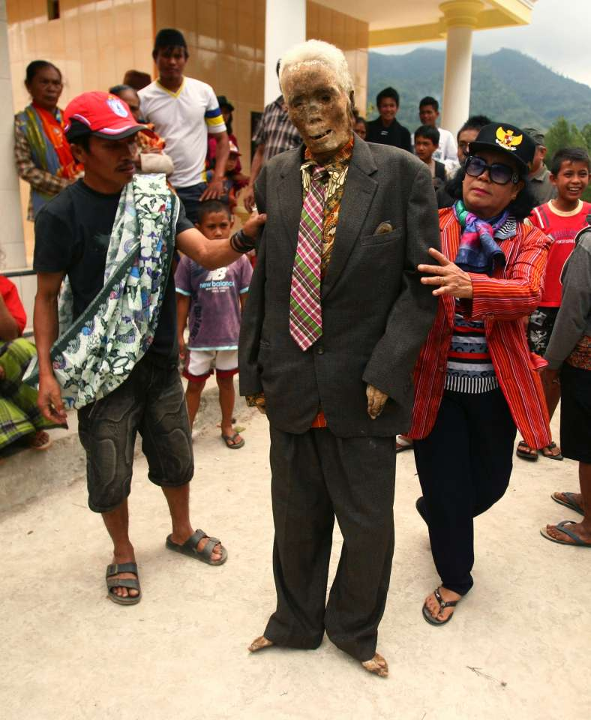
Notes:
Christian cult in Indonesia. Deceased relatives are embalmed and kept for quite a while in the house. After a time they are presented in their garments as if they were alive.
Speaking about growth we are speaking about life itself. To live is to grow. Jesus speaks to the church in Sardes:
… you have a reputation of being alive, but you are dead. (Rev 3:1 NIV)
What is life?
Looking alife? Standing up? Being clothed?
Life is independent activity and metabolism. Plus Life is reproduction.
A church without activity and reproduction is dead. Even though it migth look alive. Dead people‘s hair and fingernails still grow for a time. But this wouldn‘t fool anybody. Nobody has a problem to recognize a corpse.
In Germany some people quarrel about church growth. There is even among brethren churches a widespread book called „Dangerous Church-Growth“ by Rudolf Ebertshäuser. As the church is considered a „Little flock“, any kind of growth seems suspect.
Speaking about growth this morning I am speaking about life of the church itself. Not about numbers and statistics.

Slide 3
1. Why should we strive for church growth?
The church is the body of Christ – there is no other presence of Christ in this world then through the church only.
  Ephesian 1, ²⁰ he worked in Christ when he raised him from the dead and seated him at his right hand in the heavenly places, ²¹ far above all rule and authority and power and dominion, and above every name that is named, not only in this age but also in the one to come. ²² And he put all things under his feet and gave him as head over all things to the church, ²³ which is his body, the fullness of him who fills all in all.
Notes:
Growing churches means glorifying Jesus Christ. The aim of Christs reign now is not only his reign in the hearts of single christians, but his reign in the church. He is not my personal head (making him some kind of cephalopod).

Slide 4
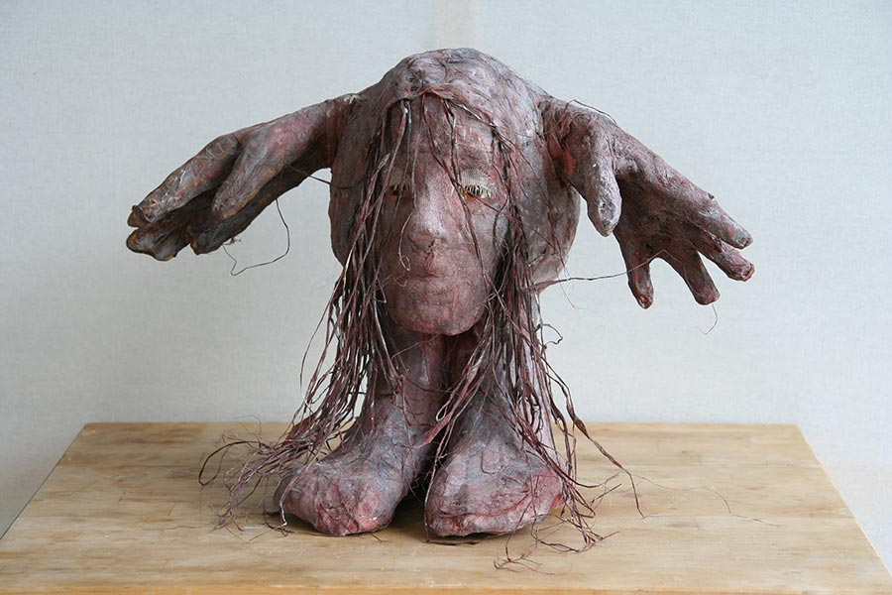
Notes:
Cephalopod!

Slide 5
1. Why should we strive for church growth?
The church is the body of Christ – there is no other presence of Christ in this world then through the church only.
Church Growth is the natural expression of an organism being alive – no growth, no life.
  Ephesians 4 ¹⁵ Instead, speaking the truth in love, we will grow to become in every respect the mature body of him who is the head, that is, Christ.¹⁶ From him the whole body, joined and held together by every supporting ligament, grows and builds itself up in love, as each part does its work.
Notes:
Growth by cell multiplication. Sustaining the body is by cell multiplication and renewing, too! A body cell has a life cyclus of about 1,5 years. I divides itself about 50 times in the lifespan of a human being, which means the average age of a human being is around 75 years. Without continous self-multiplication there would only be a time of about 1,5 years left. Living is growing and multiplying. Without multiplication and growth life would end in short time.
Growth of this kind is happening by itself. If the parts do have the connection with the head (which means they are alive) and are connected to each other (which means they serve each other), growth is inevitable.

Slide 6
1. Why should we strive for church growth?
The church is the body of Christ – there is no other presence of Christ in this world then through the church only.
Church Growth is the natural expression of an organism being alive – no growth, no life.
The existence of the church is for a purpose – it exists for growth and activity. A body which doesn‘t move and work will deteriorate.
  Acts 1 ⁸ But you will receive power when the Holy Spirit has come upon you, and you will be my witnesses in Jerusalem and in all Judea and Samaria, and to the end of the earth."
Notes:
Misunderstandings as to the gift of the Holy Spirit:
Given for Emotions and inner Experiences – may occur but are not the first purpose of the gift of the Holy Spirit
Given for developing ones own gifts – the spirit may gift a person with certain talents; but it is not given for the purpose of self-development and self-realization.
Given for enriching our services with joy and encouragemant – the spirit may bless us and our services; but that‘s not the first purpose.
Given for us being witnesses of Jesus Christ – which is inviting others into the kingdom and living a lifestyle which reflects the beauty of the gospel
Restoring the kingdom will happen by and according to the plans of the father in heaven. Our „function“ in this world is merely being witnesses.

Slide 7
2. How should we grow churches?
Organisms grow perfectly by themselves if the „natural conditions“ are right
  1 Corinthians 3 ⁶ I planted, Apollos watered, but God gave the growth.
Notes:
There is no need to command the body: „Grow! You must multiply! Otherwise, you will cease to exist! Your only chance to become fit for the future is multiplying. Now do it!“ Your body doesn‘t grow by commands but by nurturing and caring.

Slide 8
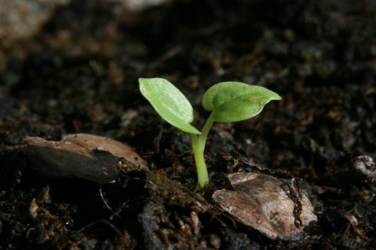

Slide 9
2. How should we grow churches?
Organisms grow perfectly by themselves if the „natural conditions“ are right
The first function of growth is the growing relationship with Jesus Christ
  Ephesians 4 ¹⁵ Rather, speaking the truth in love, we are to grow up in every way into him who is the head, into Christ, ¹⁶ from whom the whole body, joined and held together by every joint with which it is equipped, when each part is working properly, makes the body grow so that it builds itself up in love.
Notes:
Growing into Christ is the first kind of growth the body needs. When the head of the body is chopped off then no more growth is possible. The only change the body will experience is detioration and decay.
Two factors hinted to in this text:
The body parts are all linked to each other. Where this link is not established, no proper body function is possible.
Each body part is working properly.
Again, the functioning of the body is not established by teaching only, but by encouraging, supporting, helping to find ones function and contribution to the body, ackknowledging and commending. It‘s not a work some church founder does at the start of a church, but it is the continues work of the Leaders of the church. Almost every work can be delegated, but not this one. Focussing Christ first and each and every day of church life – and then focussing on the different parts of the body of Christ. According to Paul, the weaker and more demading parts do even deserve more effort and love from the leadership.

Slide 10
2. How should we grow churches?
Organisms grow perfectly by themselves if the „natural conditions“ are right
The first function of growth is the growing relationship with Jesus Christ
Nurturing is a multiple challenge which needs many gifts:
  Ephesians 4 ¹¹ And he gave the apostles, the prophets, the evangelists, the shepherds and teachers, ¹² to equip the saints for the work of ministry, for building up the body of Christ, ¹³ until we all attain to the unity of the faith and of the knowledge of the Son of God, to mature manhood, to the measure of the stature of the fullness of Christ …
Notes:
Many a views on how to understand Ephesians 4,11 – are there still the gifts of apostles and prophets present in the church of today? Are these gifts really necessary or had they been confined to creating the New Testament and that‘s it? If God wants us to use all five variations of Eph 4,11 what would that be today? Independently of this questions it is obvious that Growing Churches need Teams with different gifts. It‘s not the task of one person only.
Compare with the body functions: If you really appreciate the parts of the body being different than you should appreciate the need to have different kind of gifts to help each part find its task in the body which is according to its natural or spiritual gifts and most serves the body.

Slide 11
3. What should be the outcome of growing churches?
People who believe in Jesus Christ
  Philippians 1 ²⁷ Only let your manner of life be worthy of the gospel of Christ, so that whether I come and see you or am absent, I may hear of you that you are standing firm in one spirit, with one mind striving side by side for the faith of the gospel, ²⁸ and not frightened in anything by your opponents.
Notes:
Developing faith in the first dimension – relation to God
It‘s not a fight for the gospel in this text, by the way. It is a fight for the faith of the gospel. We are to encourage and strengthen people as to their faith! We need not defend the gospel. There is no task to complain within an secular society about the gospel not being recognized or misinterpreted or ignored. We need not feel offended when people mock about the gospel. We do not defend the gospel but we strengthen the faith of the gospel. This means, we are not primarily concerned with quarrel about texts, translations and possible interpretations but first with people! If quarrel serves to strenghten faith of the gospel, then let it be too. If not, stop it. Fight for the right purpose!
The Holy Spirit enables us to be witnesses for the faith, not warriors!

Slide 12
3. What should be the outcome of growing churches?
People who believe in Jesus Christ
People who are one in Jesus Christ
  Ephesians 4 ¹³ until we all attain to the unity of the faith and of the knowledge of the Son of God, to mature manhood, to the measure of the stature of the fullness of Christ …
Notes:
Developing faith in the first dimension – relation to God
Developing trust in the second dimension – relation to the church
Growing churches is not only developing and training of individuals but helping them striving for unity with the body. This unity is needed as to the coordinating and functioning of the body as well as to the healthy relationships among the parts of the body. Trust and Truth are the elements of healthy relationships. Be honest and trust each other. Or tell it love like in Verse 16 in the same chapter.
Turning to Christ is turning to his body at the same time. There is no following of Christ without becoming part of the body of Christ. My hand is connected to my head – if it is beaten, my brain signals pain and is worried. It will decide to withdraw my hand from the painful experience. Hand and Head are a unity, as is each part of the body with the head. Thus every member of the body of Christ is connected with him who is the head of the body. But not every part is connected physically to the head. The hand is connected to the forearm whicht is connected to the upper arm which is connected to the shoulder which is connected to the neck which is connected to the head. Some people seem to be more gifted and closer to the mouth of Jesus than others – let it be, that‘s how a body is build up. Don‘t ask the feet to listen and speak, but ask them to go!

Slide 13
3. What should be the outcome of growing churches?
People who believe in Jesus Christ
People who are one in Jesus Christ
People who are a light in this world for Jesus Christ
  Philippians 2 ¹⁴ Do all things without grumbling or disputing, ¹⁵ that you may be blameless and innocent, children of God without blemish in the midst of a crooked and twisted generation, among whom you shine as lights in the world, ¹⁶ holding fast to the word of life,
Notes:
Developing faith in the first dimension – relation to God
Developing trust in the second dimension – relation to the church
Developing a calling in the third dimension – relation to the world
Our Call is not despising the world or judging it but enlightening it with the light of the gospel! Even our ethical standards to which the Apostle Paul is referring here has as its primary purpose the reflection of the Glory of God. Interestingly enough, the witness is established by renouncing once right to be angry, to feel offended, to feel violated, to feel like you would have to push into the fellowship your discontent and disappointment.

Slide 14
Growing Churches with the right Focus
Focus on Training first, not only on Teaching – the gospel is to be understood not by your brain only, but by your heart and your life.
Notes:
Just to „know“ the gospel or the bible isn‘t enough. Church doesn‘t grow by knowledge but by the love it receives from Jesus Christ and which it hands on to people in need.

Slide 15
Growing Churches with the right Focus
Focus on Training first, not only on Teaching – the gospel is to be understood not by your brain only, but by your heart and your life.
Focus on People first, not only on Programs – church doesn‘t grow with its programs and activities but with its people
Notes:
Just to „know“ the gospel or the bible isn‘t enough. Church doesn‘t grow by knowledge but by the love it receives from Jesus Christ and which it hands on to people in need.

Slide 16
Growing Churches with the right Focus
Focus on Training first, not only on Teaching – the gospel is to be understood not by your brain only, but by your heart and your life.
Focus on People first, not only on Programs – church doesn‘t grow with its programs and activities but with its people
Focus on Gifts first, not only on Church Membership – the aim of growing churches is people taking their part in the body of Christ and serving others.
Notes:
Hier die neuen Bewegungen erklären, die ohne Mitgliedschaft arbeiten (wie früher die Brüder!). Wer näher dazu gehören will, kommt in die Mitarbeit und damit auch in das Training.
Vielleicht auch erklären:
Belonging, behaving, believing.
Believing, behaving, belonging.

Slide 17
Questions for Discussion
Why does it need more than just teachers to grow churches?
How are people in your church supported to find their place in the body of Christ? If one would ask any member of your church: „What does your life and gift contribute to the growth of this church?“, what would be the answer?
What is your real focus that becomes obvious by the structures and range of ministries offered in the church? Teaching, Programs and Membership? Training, People and Gifts?
Notes:
What about the less gifted people? How do you insert them into their proper place in the body of Christ?
Arturs Konzept:
Aufgaben übergeben:
Das Warum erklären. - Why does this task of yours contribute to the wellbeing and growth of your small group, youth group, church?
Das Wie erklären. – Methods, Procedures, Skills. What do you need to perform this task. How can we help, what training do you need?
Das Was erklären. – What kind of results are expected to come out of your work? How can it be measured that you fulfilled your task?

